Slide 1




Final-Data BootCamp Project
Building a
High Volume Streaming
Data Ingestion Platform
Jorge Castro DAPT NOV 2021
19 May 2022

Slide 2
Objective: Build a near-real-time data streaming platform on AWS to simulate the ingestion of e-Commerce data or transactions, transform and store them for different use cases.

Slide 3

Data Source:
E-Commerce Data.
Actual transactions from UK retailer
Every row is an article or an item

Slide 4
Data Ingestion Pipeline for high ingestion loads
The Platform Data Pipelines
4 Data Pipelines to handle data from a point A to B
Stream to S3 Raw Storage Pipeline
Stream to DynamoDB Pipeline
2 Data Visualization Pipelines
Batch Processing Pipeline for Bulk Import
Visualization Pipeline Redshift Data Warehouse
Visualization Pipeline API

Slide 5
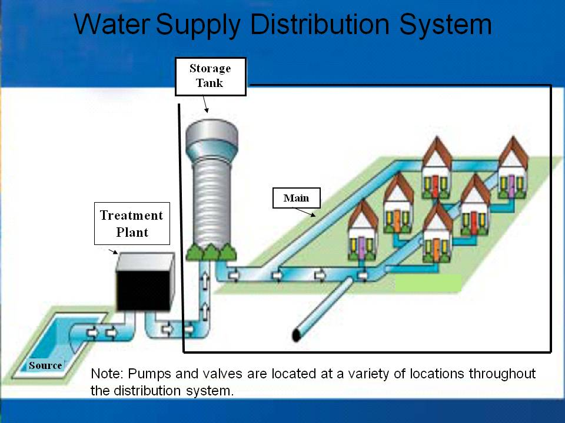





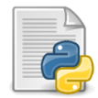


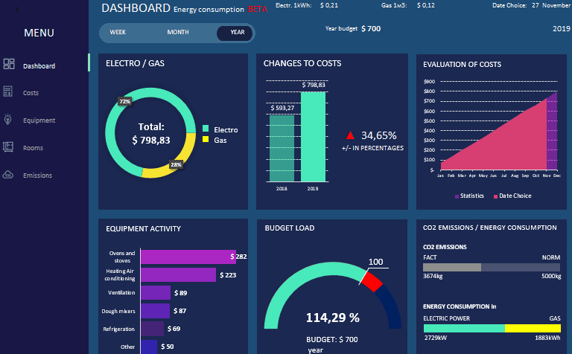





High Volume Streaming Data Ingestion Platform on AWS
Response
Body = Rows
Visualization API
Water Suppy Distribution System
HTTP GET Request
Lambda Function
DynamoDB
Invoices Table
DynamoDB
Customers Table
Batch Processing Data Pipeline for Bulk Import
Near-Real Time Analytics
API Gateway
Python Client Simulation
Transactions Streaming
HTTP POST
Body = Rows
S3 Storage
Lambda Function
Power BI
Lambda Function
Glue Job (Spark)
Kinesis Data Stream
Lambda Function
Redshift Data Warehouse
Redshift Data Warehouse
S3 Temp Storage
Kinesis Firehose
Delivery Streams
S3 Storage Data Lake
Raw Data

Slide 6
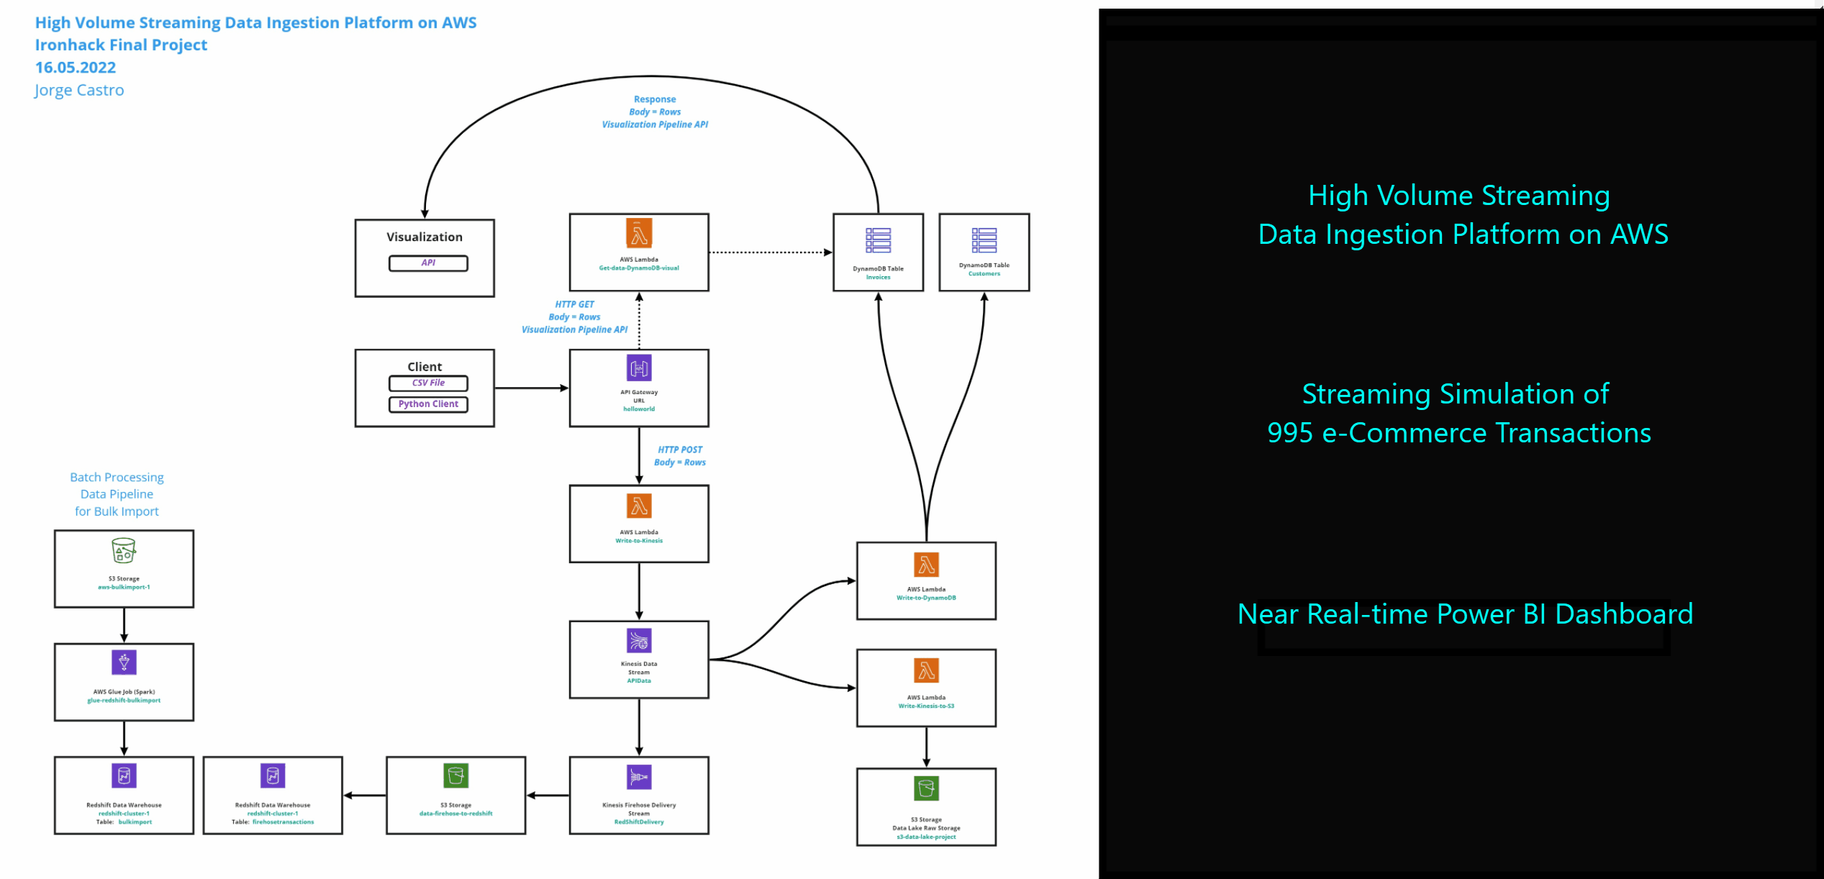
Demo Near Real-time data Stream Dashboard on Power BI

Slide 7








Tools used:
Python
Power BI
API Gateway
Lambda Function
Kinesis Data Stream
Kinesis Firehose Delivery Streams
DynamoDB
S3 Storage
Glue
Redshift

Slide 8
Thank You!!

